Slide 1
Paris
Famous landmarks (B)

Slide 2
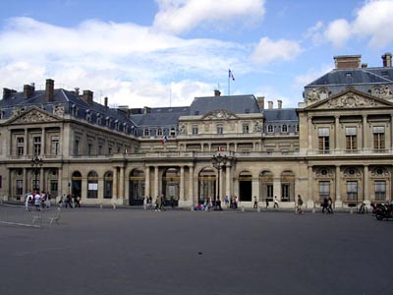
Le Palais Royal
Notes:
2

Slide 3
Le Palais Royal
Across from the Louvre
Home of the Queen Mother Anne of Austria and her young son Louis XIV, with her advisor Cardinal Mazarin
Now houses the Constitutional Council and the Ministry of Culture

Slide 4
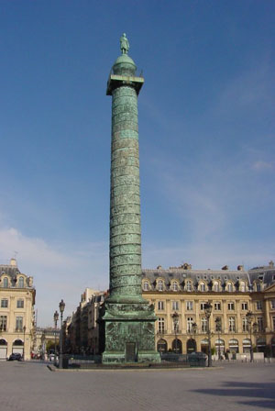
La Place Vendome
Notes:
4

Slide 5
La Place Vendôme
Monument commissioned by Napoléon to commemorate his victory at Austerlitz
Made of melted cannons
Statue of Napoleon at the top
Area for perfumers, bankers, Ritz Hotel
Notes:
5

Slide 6
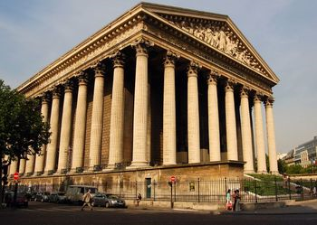
La Madeleine
Notes:
6

Slide 7
La Madeleine
Designed in the style of a Greek temple
Built for the glory of Napoleon’s army
Built in 1842
Notes:
7

Slide 8
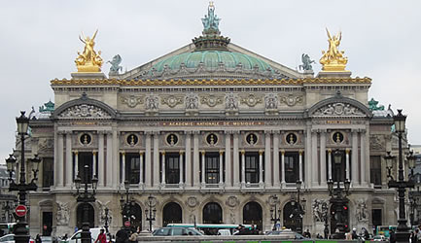
L’Opéra Garnier
Notes:
8

Slide 9
L’Opéra Garnier
Largest theater in the world at the time of its construction (begun in 1861)
Ceiling painted by Marc Chagall in 1964
Marble staircase
Crystal chandelier weighs more than 6 tons
Underground lake & cellars inspired “The Phantom of the Opera” by Gaston Leroux
Notes:
9

Slide 10
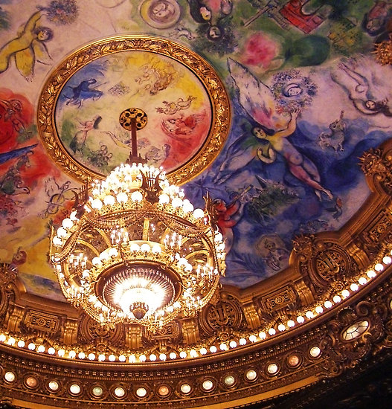
L’Opéra Garnier
Notes:
10

Slide 11
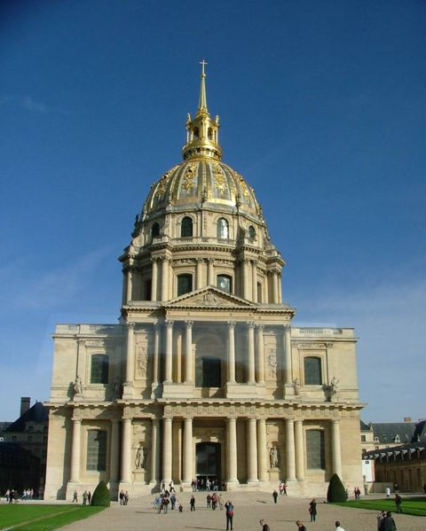
Les Invalides
Notes:
11

Slide 12
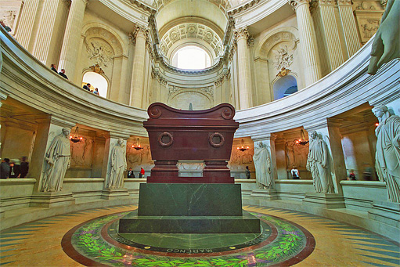
Les Invalides
Notes:
12

Slide 13
Les Invalides
Built as military hospital started in 1670
Military history museum
Tomb of Napoleon
Notes:
13

Slide 14
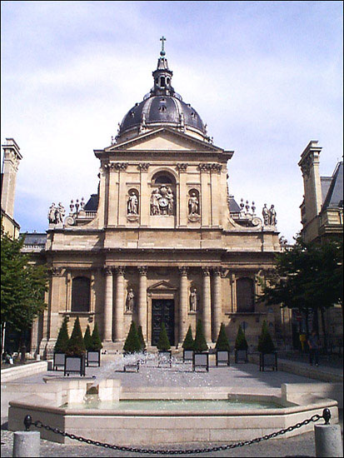
La Sorbonne
Notes:
14

Slide 15
La Sorbonne
One of oldest universities in the world
Founded in 1257
Center of theological studies
Located in the Quartier Latin
Notes:
15

Slide 16
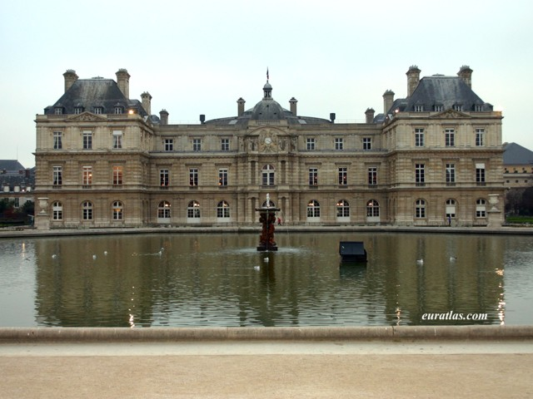
Le palais du Luxembourg

Slide 17
Le palais du Luxembourg
Former residence of Queen Marie de Medicis
Now houses French senate
Beautiful gardens open to public

Slide 18
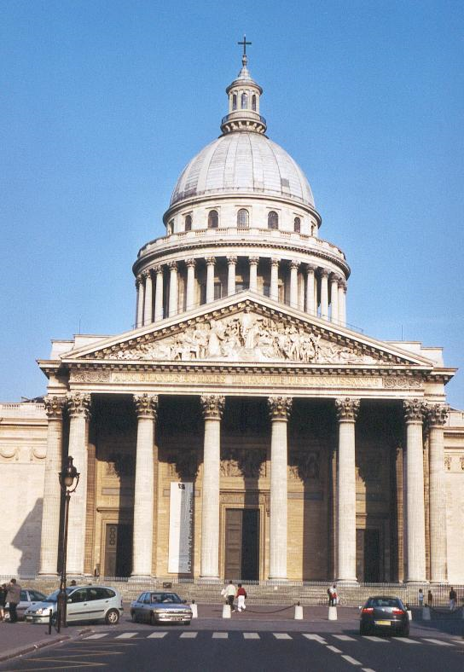
Le Panthéon

Slide 19
Le Panthéon
Mausoleum
Famous men of France entombed here
Marie Curie 1st woman here
Notes:
19

Slide 20
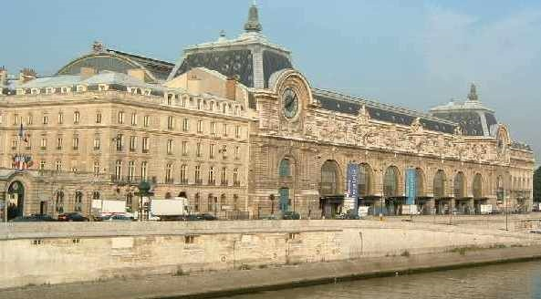
Le Musée d’Orsay

Slide 21
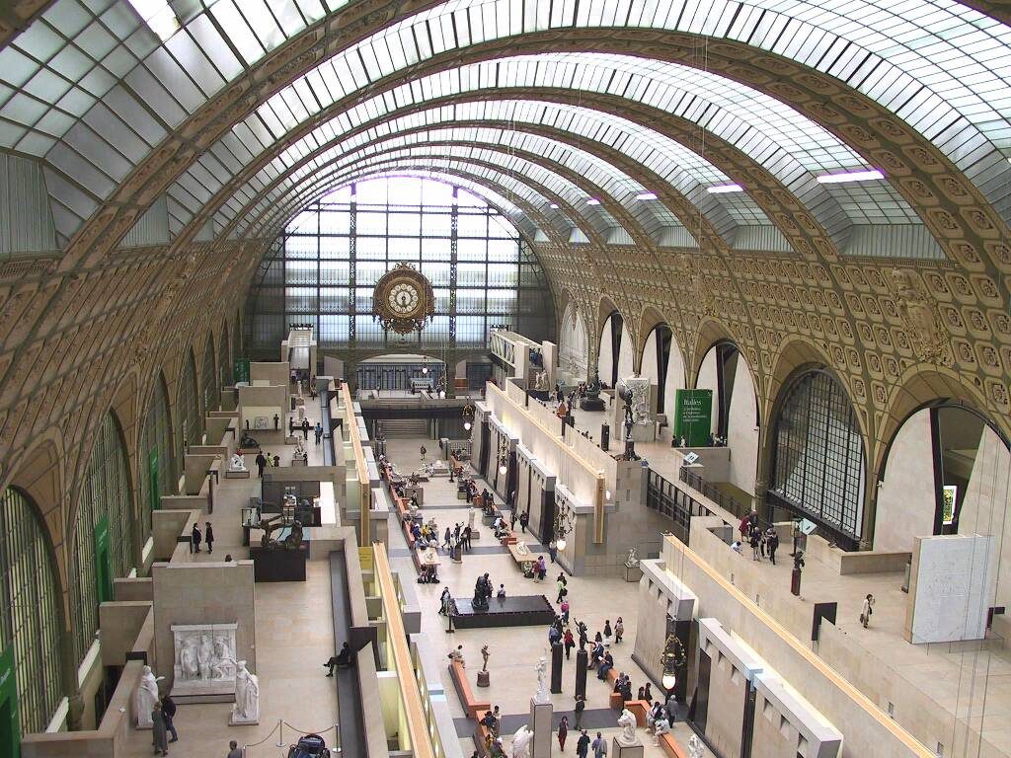
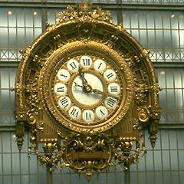
Le Musee d’Orsay
Notes:
21

Slide 22
Le Musée d’Orsay
Was a train station
Opened in 1986
Impressionist art museum
Home to the works of Monet, Renoir, Degas, Cézanne
Notes:
22

Slide 23
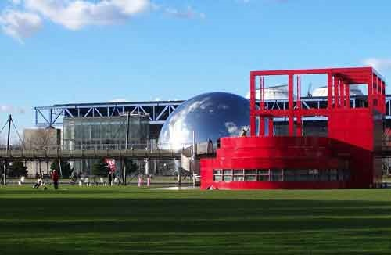
Le Parc de la Villette

Slide 24
Le Parc de la Villette
Largest fully-landscaped park in Paris
Devoted to science and music
Geode has Omnimax screen
Museum of Science and Industry
Many playgrounds for children
Notes:
24

Slide 25
L’Arche de la Défense

Slide 26
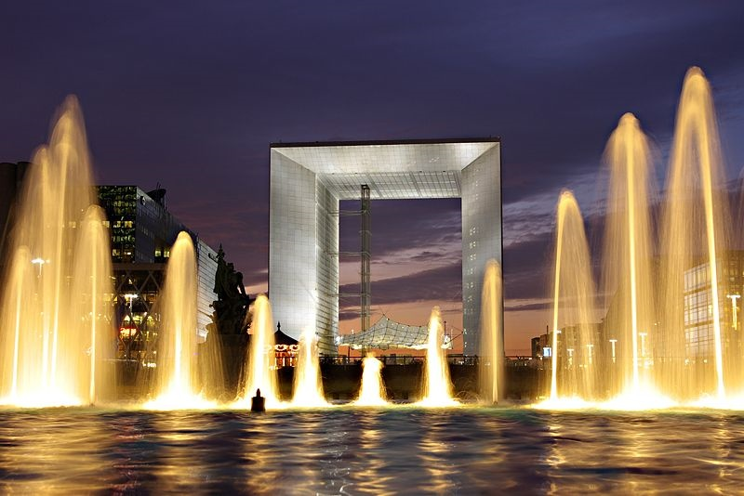
L’Arche de la Défense

Slide 27
L’Arche de la Défense
Built in 1989 for bicentennial of the French Revolution
In business district
Modern version of the Arc de Triomphe – praising humanity & humanitarian ideals rather than military victories
2 sides house government offices
Roof section is an exhibition center

Slide 28
Le Pont Neuf

Slide 29
Le Pont Neuf
Oldest bridge in Paris
Built in 1577
Has 2 spans – connecting the left bank to Ile de la Cité and then to the right bank

Slide 30
Le Pont Alexandre III

Slide 31
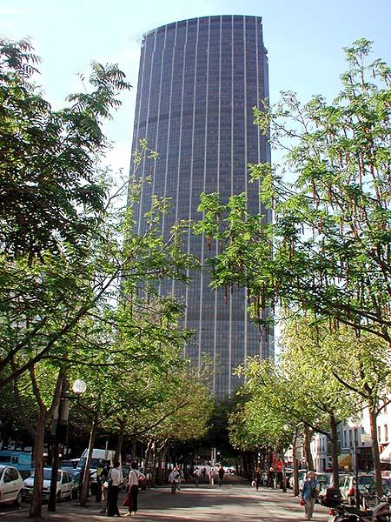
La Tour Montparnasse

