Slide 1
Paris
Famous landmarks (A)

Slide 2
Place Charles de Gaulle L’Etoile

Slide 3
Introduction
https://www.youtube.com/watch?v=f-3QQTM76Xk

Slide 4
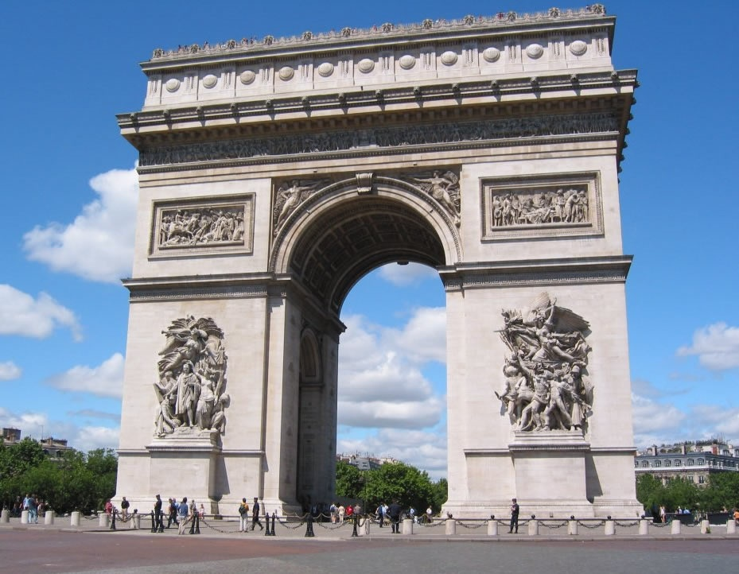
L’Arc de Triomphe
Notes:
4

Slide 5
L’Arc de Triomphe
Commissioned to be built in 1806 to commemorate Napoleon’s victories
Tomb of the Unknown Soldier
Eternal Flame
Notes:
5

Slide 6
Les Champs-Élysées
Notes:
6

Slide 7
Les Champs-Élysées
2 km
Most famous avenue
- Shops, restaurants

Slide 8
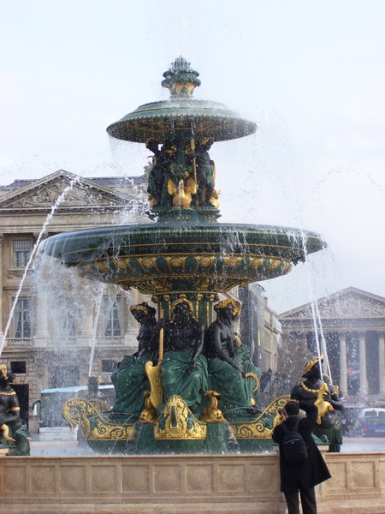
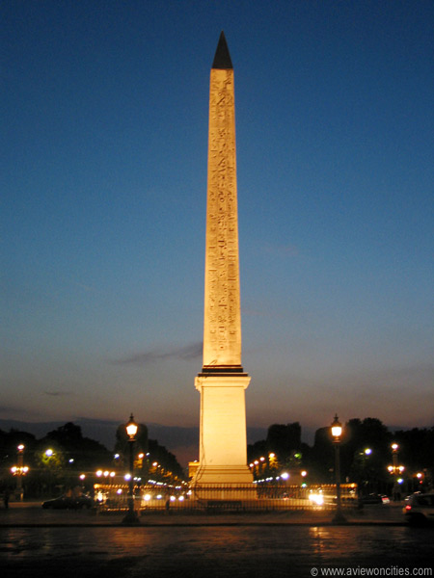
La Place de la Concorde
Notes:
8

Slide 9
La Place de la Concorde
Notes:
9

Slide 10
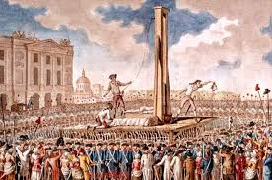
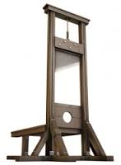

Slide 11
La Place de la Concorde
The largest square in Paris
Site of the guillotine during the French Revolution
Now has Obelisk, which was a gift from Egypt in 1829
Obelisk is 3300 years old
Notes:
11

Slide 12
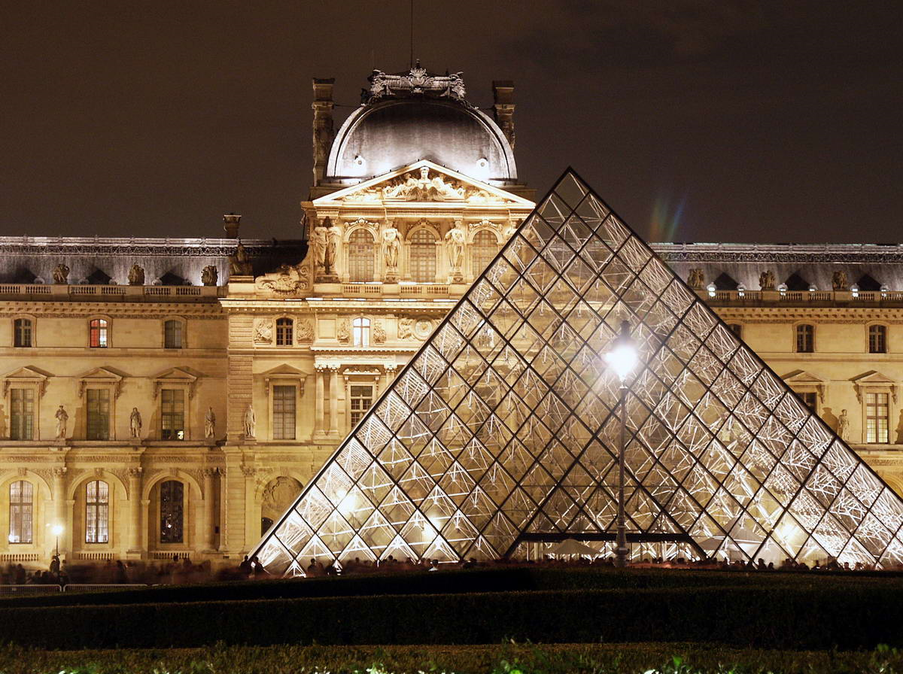
Le Louvre
Notes:
12

Slide 13
Le Louvre
Notes:
13

Slide 14
Le Louvre
Originally a fortress to protect France’s treasures
Also served as a palace & a prison
World’s richest, most visited museum
Mona Lisa , Venus de Milo & Winged Victory housed here
Glass pyramid for the entrance, designed by American I.M.Pei
Notes:
14

Slide 15
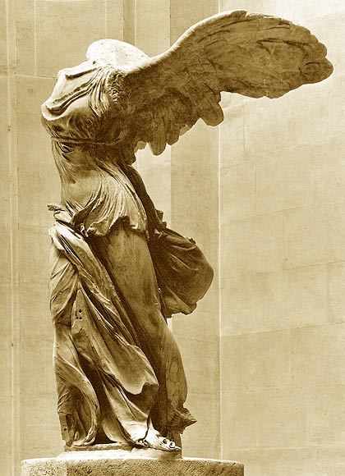
Le Louvre
Notes:
15

Slide 16
La Conciergerie
Notes:
16

Slide 17
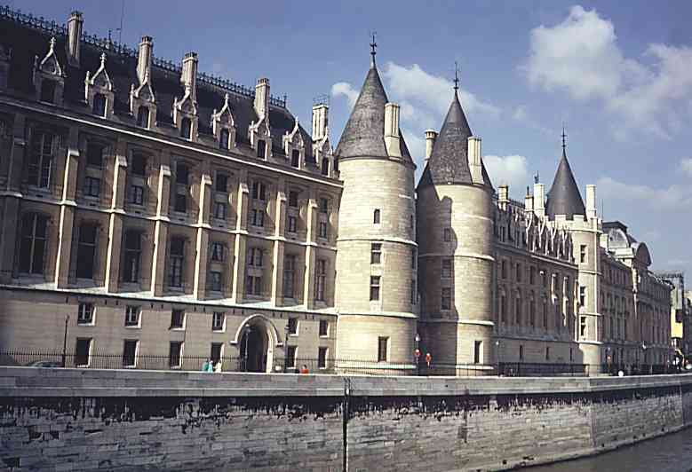
La Conciergerie
Notes:
17

Slide 18
La Conciergerie
Former Royal palace
Built by Philippe the Fair (1284 – 1314)
Oldest prison in France
Prisoners held here before being guillotined
Marie Antoinette held prisoner here during the Revolution before being beheaded
Her cell is now a chapel to her memory
Building now houses the Palais de Justice
Notes:
18

Slide 19
La Conciergerie
Notes:
19

Slide 20
L’ Île de la Cité
Le berceau de Paris
Notes:
20

Slide 21
Place where the Celts tribe the Parisii settled 300 BC

Slide 22
Notre Dame
Notes:
22

Slide 23
Notre Dame
Construction began in 1163; finished in 1345
One of the first buildings in the world to use flying buttresses
December 2, 1804 – Napoleon crowned himself Emperor of the Holy Roman Empire here
Notes:
23

Slide 24
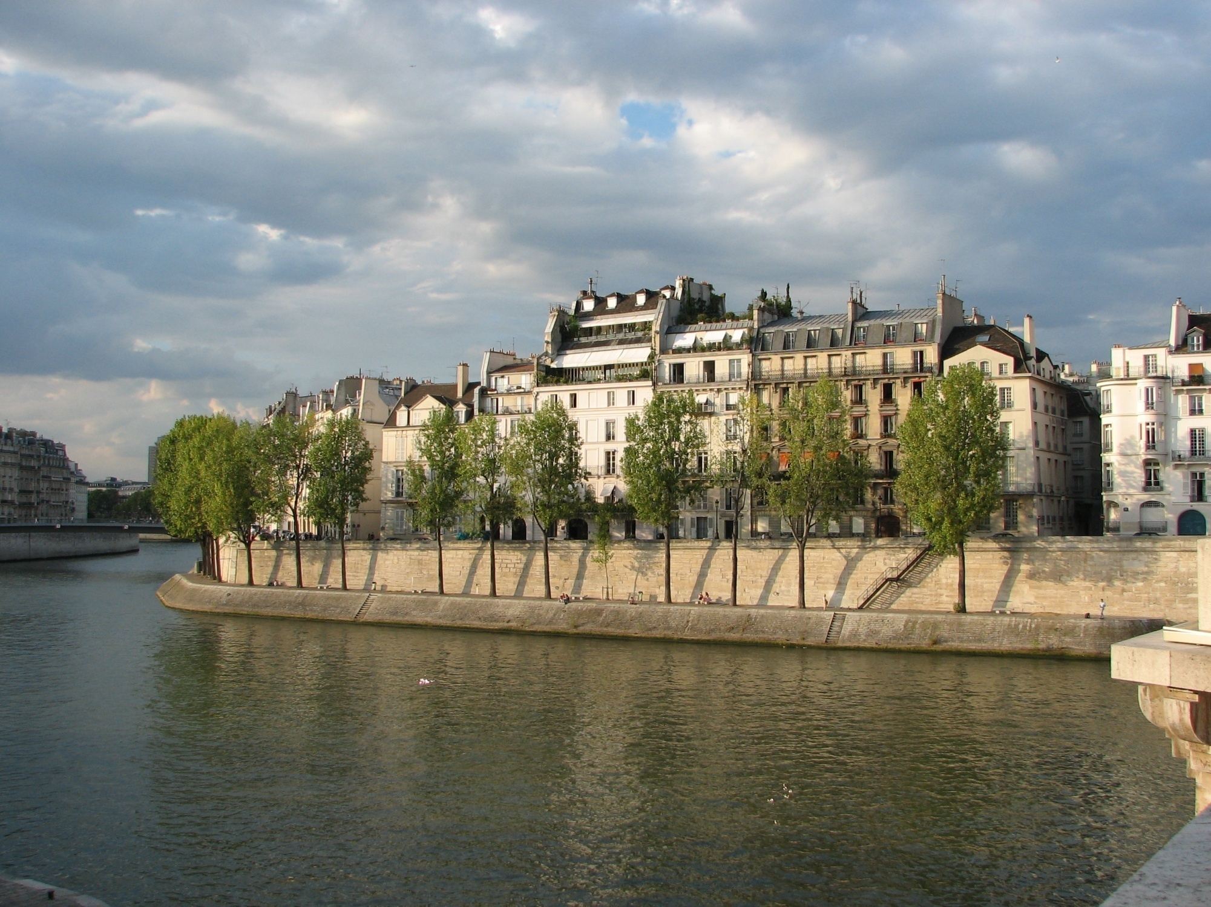
L’Île St. Louis
Notes:
24

Slide 25
Residential neighborood.

Slide 26
L’Hôtel de Ville
Notes:
26

Slide 27
L’Hôtel de Ville
Houses the city administration for Paris
It has filled this role since 1357
Used for many large receptions
Notes:
27

Slide 28
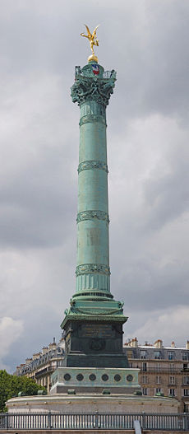
La Place de la Bastille
Notes:
28

Slide 29
La Place de la Bastille
Site of former Bastille prison
Attacked on July 14, 1789, starting the French Revolution
Torn down by the people
Now has column with St Anthony at top
Notes:
29

Slide 30
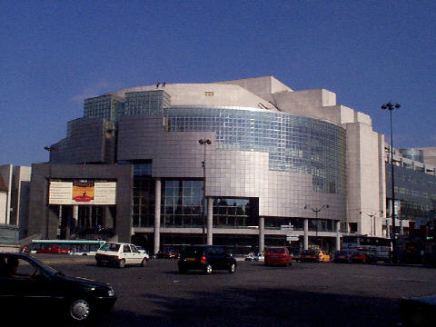
L’Opéra de La Bastille
Notes:
30

Slide 31
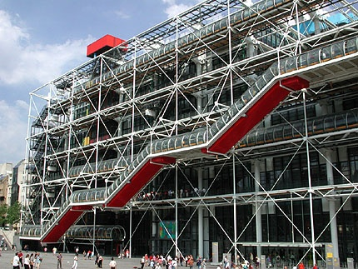
Le Centre Pompidou
Notes:
31

Slide 32
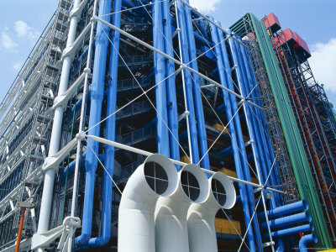
Le Centre Pompidou
Notes:
7000 tons; 2.5 mil bolts; 12,000 pieces of steel; painted every 7 yrs with 52 tons of paint
32

Slide 33
Le Centre Pompidou
Factory style architecture
Pipes on outside
Modern Art Museum
Large public library
Also known as Beaubourg
Renamed in honor of President Pompidou after his death
Notes:
33

Slide 34
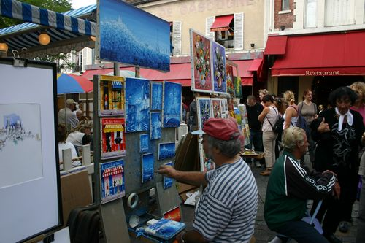
Montmartre
Notes:
34

Slide 35
Montmartre
Name of the district around Sacré Coeur
Home to many artists
Monet, Picasso & Van Gogh all had studios here
Notes:
35

Slide 36
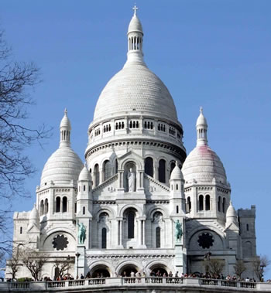
Le Sacré Coeur
Notes:
36

Slide 37
Sacré Coeur
Notes:
37

Slide 38
Le Sacré Coeur
Highest point of land in Paris
Built as an act of contrition following the loss of the Franco-Prussian war in 1871
Byzantine architectural style
Notes:
38

